Slide 1

MIT-5201
By-
Jesmin Akhter
Associate Professor
Institute of Information Technology
Jahangirnagar University

Slide 2
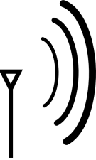
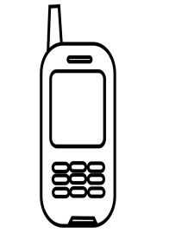
Channel Utilization in WiMAX -Traditional Model
1-to-1 channel allocation
...
...
Allocating radio channel to an individual user

Slide 3
FDMA
Total system bandwidth is divided into narrow frequency slots.
FDMA assigns individual channels to individual users
A user is free to transmit or receive all the time on its allocated radio channel, but the cost of transceiver is high, as each has to be designed on a different band
Guard bands are maintained between adjacent signal spectra to minimize cross talk between channels
During the period of call no other user can share the same frequency band
Each user transmits with no limitations in time, but using only a portion of the whole available frequency bandwidth.
Different users are separated in the frequency domain
In frequency division duplex (FDD) systems, the users are assigned a channel as a pair of frequencies. One frequency is used for the upward channel, while the other frequency is used for the downward channel

Slide 4
FDMA-Disadvantages
FDMA wastes bandwidth. If an FDMA channel is not in use, then it sits idle and cannot be used by other users to increase or share capacity.
The FDMA mobile users unit uses duplexers since both the transmitter and receiver operate at the same time. A duplexers add weight, size and cost to a radio transmitter and can limit the minimum size of a subscriber unit
FDMA requires tight RF filtering to minimize adjacent channel interference

Slide 5
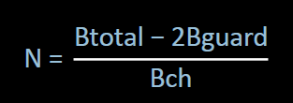
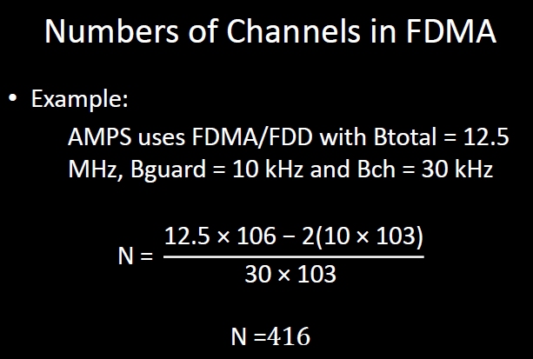
Numbers of Channels in FDMA
Let Btotal be the total system bandwidth, Bguard be the guard band at edge, and Bch the single radio channel bandwidth. Then the number of channels in a FDMA system:

Slide 6


Enhancing Channel Utilization in WiMAX -Modification Model
1-to-m channel allocation
m-to-n channel allocation
...
...
...
A channel is allocated to a user group.
A group of channels are allocated to a user group.
...

Slide 7
TDMA
In digital systems, continuous transmission is not required because users do not use the allotted bandwidth all the time. In such cases, TDMA is a complimentary access technique to FDMA.
Global Systems for Mobile communications (GSM) uses the TDMA technique.
In TDMA, the entire bandwidth is available to the user but only for a finite period of time. In most cases the available bandwidth is divided into fewer channels compared to FDMA and the users are allotted time slots during which they have the entire channel bandwidth at their disposal.
TDMA requires careful time synchronization since users share the bandwidth in the frequency domain.
The number of channels are less, inter channel interference is almost negligible.
TDMA uses different time slots for transmission and reception. This type of duplexing is referred to as Time division duplexing(TDD).

Slide 8
Features of TDMA
TDMA shares a single carrier frequency with several users where each users makes use of non overlapping time slots.
The number of time slots per frame depends on several factors such as modulation technique, available bandwidth etc.
Data transmission in TDMA is not continuous but occurs in bursts. This results in low battery consumption since the subscriber transmitter can be turned OFF when not in use. Because of a discontinuous transmission in TDMA the handoff process is much simpler for a subscriber unit, since it is able to listen to other base stations during idle time slots.
TDMA uses different time slots for transmission and reception thus duplexers are not required.
TDMA has an advantage that is possible to allocate different numbers of time slots per frame to different users. Thus bandwidth can be supplied on demand to different users by concatenating or reassigning time slot based on priority.

Slide 9
Spread Spectrum Multiple Access(SSMA)
Spread spectrum multiple access (SSMA) uses signals which have a transmission bandwidth whose magnitude is greater than the minimum required RF bandwidth.
A pseudo noise (PN) sequence converts a narrowband signal to a wideband noise like signal before transmission.
SSMA is not very bandwidth efficient when used by a single user. However since many users can share the same spread spectrum bandwidth without interfering with one another, spread spectrum systems become bandwidth efficient in a multiple user environment.
There are two main types of spread spectrum multiple access techniques:
Direct sequence multiple access (DSMA) or Code division multiple access (CDMA).
Frequency hopped multiple access (FHMA)

Slide 10
Hybrid Spread Spectrum Techniques
Direct Sequence/Frequency Hopped Multiple Access Techniques (DS/FHMA):
A direct sequence modulated signal whose center frequency is made to hop periodically in a pseudo random fashion is used in this technique.
One of the advantages using this technique is they avoid near-far effect. However, frequency hopped CDMA systems are not adaptable to the soft handoff process since it is difficult to synchronize the frequency hopped base station receiver to the multiple hopped signals.

Slide 11
Hybrid Spread Spectrum Techniques
Time and Code Division Multiple Access (TCDMA):
In this TCDMA method different cells are allocated different spreading codes.
When a handoff takes place the spreading code of that user is changed to the code of the new cell.
TCDMA also avoids near-far effect as the number of users transmitting per cell is one.
In each cell, only one user per cell is allotted a particular time slot.

Slide 12
Hybrid Spread Spectrum Techniques
Time Division Frequency Hopping (TDFH):
This technique has been adopted for the GSM standard, where the hopping sequence is predefined and the subscriber is allowed to hop only on certain frequencies which are assigned to a cell.
The subscriber can hop to a new frequency at the start of a new TDMA frame, thus avoiding a severe fade or removal event on a particular channel. This technique has the advantage in severe multipath or when severe channel interference occurs.

Slide 13
Space Division Multiple Access
SDMA utilizes the spatial separation of the users in order to optimize the use of the frequency spectrum.
A primitive form of SDMA is when the same frequency is reused in different cells in a cellular wireless network.
The radiated power of each user is controlled by Space division multiple access.
SDMA serves different users by using spot beam antenna.
These areas may be served by the same frequency or different frequencies.
However for limited co-channel interference it is required that the cells be sufficiently separated.
When different areas are covered by the antenna beam, frequency can be re-used, in which case TDMA or CDMA is employed, for different frequencies FDMA can be used.

Slide 14
Connection admission control
Connection admission control / Call admission control. (CAC) is a set of actions and permissions in network communication that identifies where the connection is permitted on the basis of network ability.
This designed set of network actions is initiated during the call setup or when calls are reconnected.
CAC is also used to decide which traffic should be allowed or rejected by a specific network.
CAC is most often used in ATM (Asynchronous Transfer Mode ) networks. CAC is the traffic control function of an ATM network responsible for accepting and blocking calls to maintain an acceptable quality of service while maximizing network utilization.

Slide 15
Connection admission control
Call Admission Control (CAC) prevents oversubscription of VoIP networks.
It is used in the call set-up phase and applies to real-time media traffic as opposed to data traffic.
It prevents voice traffic congestion, it is a preventive Congestion Control Procedure. It ensures that there is enough bandwidth for authorized flows.

Slide 16
Connection Admission Control (CAC) Algorithm
Algorithm Considering a subscriber station
The combined traffic from a group of users is accumulated in a single queue
Traffic is carried through multiple connections.
The call admission control scheme used for such subscriber station uses two criterions to accept or reject a connection:
If the number of connections exceeded a threshold N then the newly arrived user is rejected.
If the length of queue exceeds the threshold then any new connection is rejected.

Slide 17
Enhancing Channel Utilization in WiMAX
Most of the time traffic arrival in a network is found turbulent since a server has to deal with different traffic of different length and priority level.
This turbulent traffic creates excess network congestion and degrade network performance.
To combat the situation, the traffic of irregular arrival has to be converted to arrival of uniform rate.
This motivates to develop an analytical framework to consider the traffic shaping algorithms

Slide 18
Traffic shaping algorithms
Spacing between incoming packets has an irregular pattern, which in many cases causes congestion.
The goal of traffic shaping in a communication network is to control access to available bandwidth to regulate incoming data to avoid congestion, and to control the delay acquired by packets
Turbulent packets at rate λ and with irregular arrival patterns are regulated in a traffic shaper over equal-sized 1/g intervals.
Traffic shaping also prevents packet loss by preventing the sudden increased usage of system bandwidth.
The stochastic model of a traffic shaper consists of a system that converts any form of traffic to a deterministic one.
Two of the most popular traffic-shaping algorithms are leaky
bucket and token bucket.
Notes:
λ arrival rate of turbulent traffic
G constant arrival rate

Slide 19
leaky-bucket algorithm
This algorithm converts any turbulent incoming traffic into a smooth, regular stream of packets.
A leaky-bucket interface is connected between a packet transmitter and the network.
No matter at what rate packets enter the traffic shaper, the outflow is regulated at a constant rate, much like the flow of water from a leaky bucket.

Slide 20
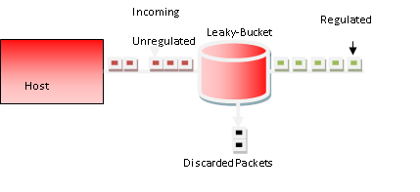
Leaky-Bucket traffic shaping algorithm
Consider the Leaky–Bucket algorithm.
Leaky-Bucket in a computer is found as finite queued buffer in network interface card controlled by operating system.
The bursty traffic generated inside the computer are temporarily stored on the buffer and drains at a constant rate so that adjacent switching can tolerate that flow.
In case of overflow of incoming traffic,
Some packets will be discarded and in this case some priority level of packets can be inserted in the packet header to take the intelligent decision.
Fig. Leaky-Bucket traffic shaping algorithm
Notes:
Now we have the Traffic Shaping Scheme that is incorporated in our system.
Two most widely used Traffic Shaping Schemes are-
Leaky Bucket
Token Bucket
We considered Leaky–Bucket algorithm.
Leaky-Bucket in a computer is found as finite queued buffer in network interface card controlled by operating system.
Most of the time The bursty traffic generated inside the computer are temporarily stored on the buffer and
drains at a constant rate so that adjacent switching can tolerate that flow.
In case of overflow of incoming traffic,
-Some packets will be discarded and in this case some priority level of packets
can be inserted in the packet header to take the intelligent decision.

Slide 21
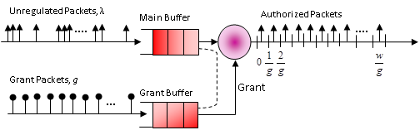
Leaky-Bucket traffic Traffic Shaping Scheme
The Leaky–Bucket scheme is sometimes modeled by two buffers,
one for incoming packets called main buffer
the other for authorization called grant buffer.
Fig. 2 Leaky-Bucket traffic shaping algorithm with queuing model

Slide 22
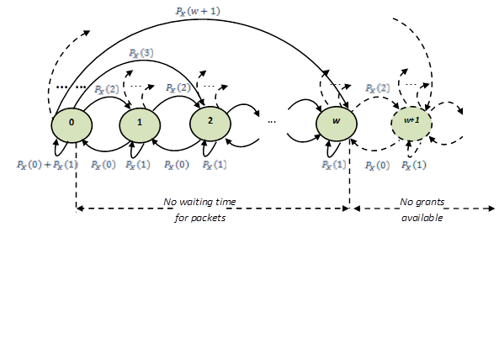
The state transition chain of a leaky-bucket
The state transition chain of leaky-bucket algorithm can be explained here.
For instance, the circle symbol represents the current calls in the bucket which are in service state. But its maximum sixe is w.
When the call request more than w then call could be wait for a time. The mean waiting time for a call is expressed by the equation:---
Where,
Pi, The probability states of occupancy of i calls
and g is packet arrival rate
Since the size of the bucket is w hence any probability state i ≤ w is the in service state
The states i > w are the states in No grants available.
mean waiting period of a packet, E[T]

Slide 23
Thank you

